Slide 1
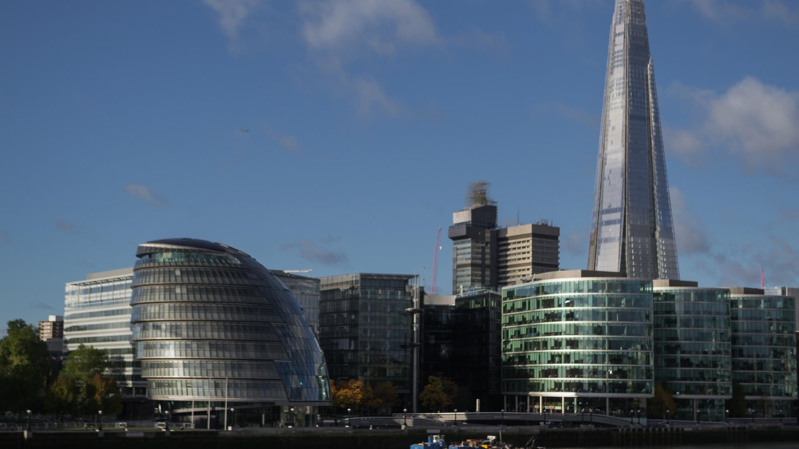
London Office of Technology and Innovation
- A New Deal for City Data

Slide 2
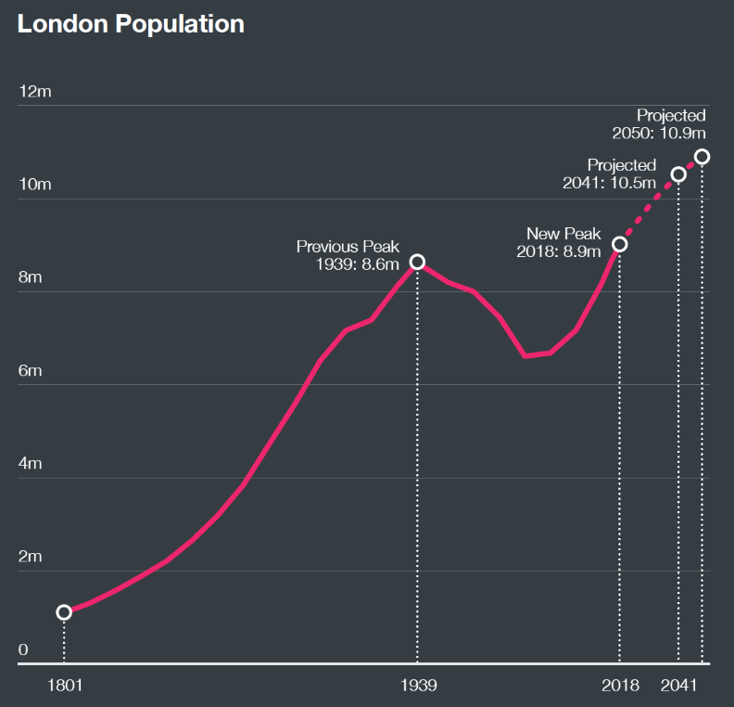
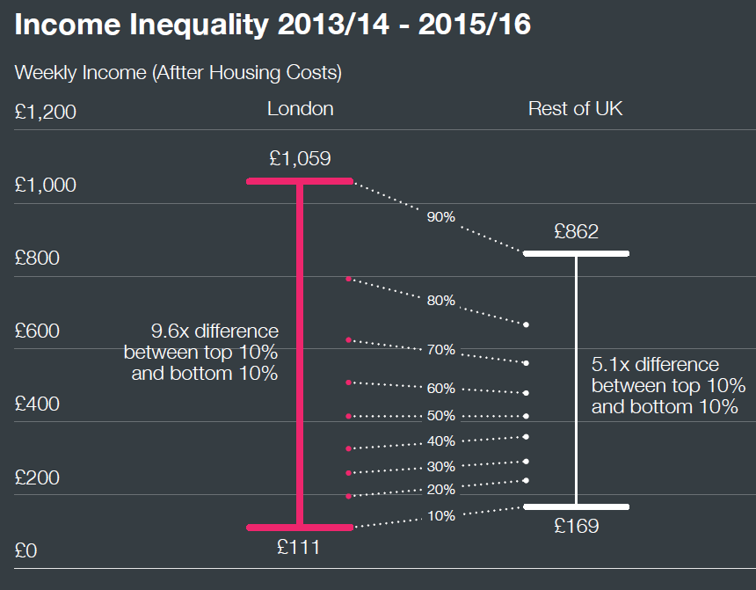

London’s challenges
Ensure good growth and improve city-wide collaboration

Slide 3

London Office of Technology & Innovation
Mission 1: More user-designed services
Mission 2: New Deal for City Data
Mission 3: World-class connectivity and smarter streets
Mission 4: Enhance digital leadership and skills
Mission 5: Improve city-wide collaboration

Slide 4
London Office of Technology & Innovation
Mission 1: More user-designed services
Mission 2: New Deal for City Data
City Data Analytics Programme
Developing a city-wide cyber security strategy
Strengthening data rights and accountability to build trust
Supporting an open ecosystem to increase transparency and innovation
Mission 3: World-class connectivity and smarter streets
Mission 4: Enhance digital leadership and skills
Mission 5: Improve city-wide collaboration

Slide 5

City Data Analytics Pilot
1 month
5 months
1 month
3 months
Problem identification
Data gathering
and preparation
Analysis / modelling
Mobilise front-line
staff
Most significant effort here

Slide 6
City Data Analytics Programme
information governance
data science
technical
project development
project development
a hub for the
development, commissioning and implementation of
data science projects aimed at
addressing public services and urban challenges
which are better tackled together,
and which may affect more than one agency

Slide 7

information governance
City Data Analytics Programme
A catalogue of data sharing agreements
  For a given dataset – who am I sharing it with (and under what terms)?
  For a given organisation – what are we already sharing with them?
Create ‘high-level’ agreements between organisations
  Signed off by Information Governance lead
  Can be referenced by the individual data flows
  Organisation assurance
Electronic signoff
  Delegated authority
ISG is ICO compliant and will be GDPR compliant
100 initial licences
  entity that has its own Information Governance set up
  Unlimited ‘sponsored organisations’

Slide 8
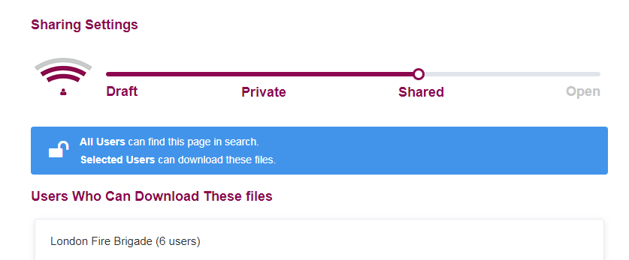
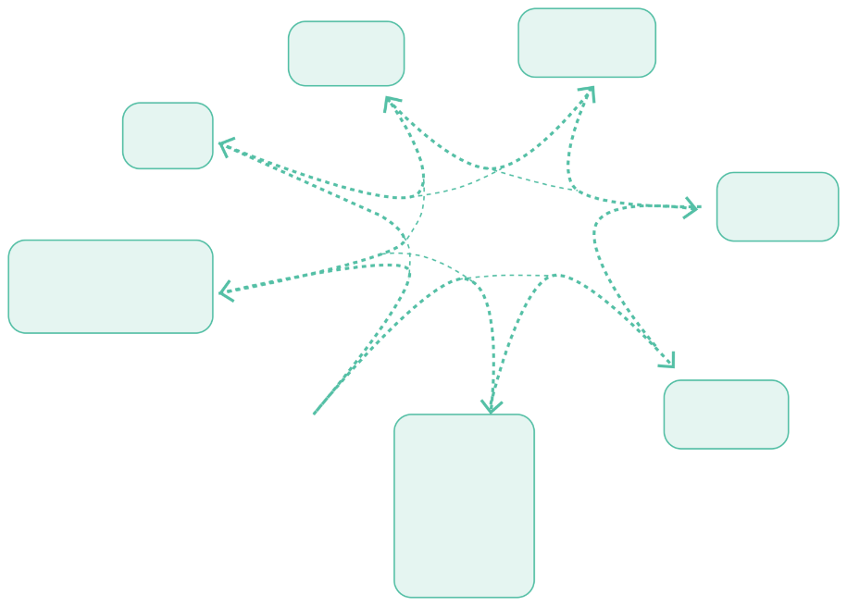

technical
City Data Analytics Programme
There will never be a single warehouse for all of London’s data, so we need to connect..
LONDON GOV
London Boroughs
Central Government
Academic Institutions
City
DataStore
LfB
Principles:
Open Source
Cloud-based
Open APIs
Sharing knowledge with other cities
secure sharing of catalogues &/or data
Charities
TfL
Business

Slide 9
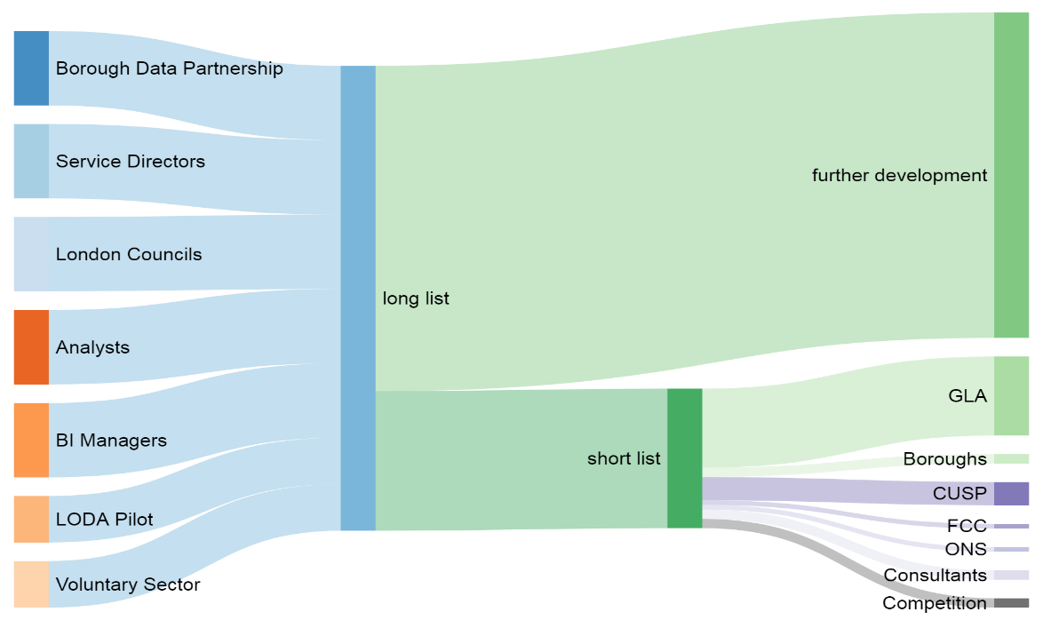

project development
City Data Analytics Programme
Sifting, prioritising & development
Project ideas
Delivery
Example of how the project pipeline could operate - with thanks to

Slide 10

data science
City Data Analytics Programme
Houses in Multiple Occupation (HMOs)
Visiting at random = 1 in 200 chance
Data for service improvement
Data for better decision making & policy
Urban Experimentation
Predictive model chance

Slide 11



data science
City Data Analytics Programme
To bring data into AQ models from a range of quality of sensors
monitor the effectiveness of the different interventions planned across London
present best estimates / forecasts to app and web developers
Data for service improvement
Data for better decision making & policy
Urban Experimentation
Notes:
given that cities are places of increasingly intense experimentation with data,

Slide 12
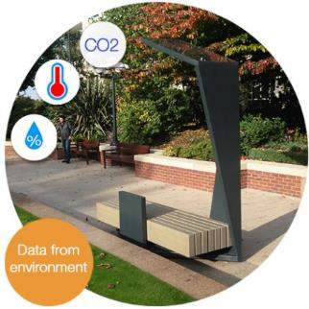
data science
City Data Analytics Programme
Data for service improvement
Data for better decision making & policy
Urban Experimentation
Training data
10 sensors
100 sensors
1000 sensors

Slide 13
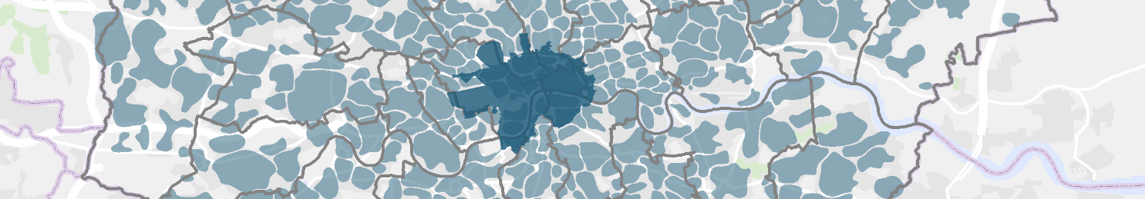
City Data Analytics Programme
Pipeline of projects
Create, share (& maintain) core reference datasets
Create right environment to support innovation
Facilitate data sharing to high ethical standards
Engage constructively with ‘Volunteered Geographic Information’ communities

