Slide 1
Cyber security policy in an evolving landscape
Rowena Schoo
Senior Policy & Communications Advisor
Notes:
Incentives & Regulations Team
Cyber Security and Data Protection Directorate

Slide 2
Introduction
Overview
Current challenges
Future policy direction
Practical tips
Questions

Slide 4
Defend against cyber threats
Deter our adversaries
Develop our skills and capabilities
& more...

Slide 5
Every organisation in the UK is cyber secure and resilient to support a prosperous digital economy

Slide 6
Organisations know what to do to be secure and resilient

Slide 9
Organisations have access to the products and services they need

Slide 12
Organisations have access to the cyber security skills they need

Slide 15
Organisations take appropriate action to protect themselves and their customers

Slide 16
Strong justification for regulation to secure personal data
Implement NIS

Slide 17
GDPR personal data must be processed securely using appropriate technical and organisational measures

Slide 18
‘appropriate’ action
In other words you need to manage risk
NCSC & ICO

Slide 19
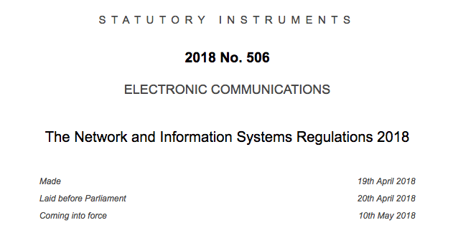

Slide 20
Operators of Essential Service
Implement security measures to manage risks to the network and information systems
Report incidents affecting the continuity of services

Slide 22
We know there is more to do

Slide 23
Only 50% of organisations are taking the most basic measures

Slide 24
EXAMPLE Despite being patched a year ago...
80% of user companies are downloading the pre-patch version of the software that took down Equifax

Slide 28
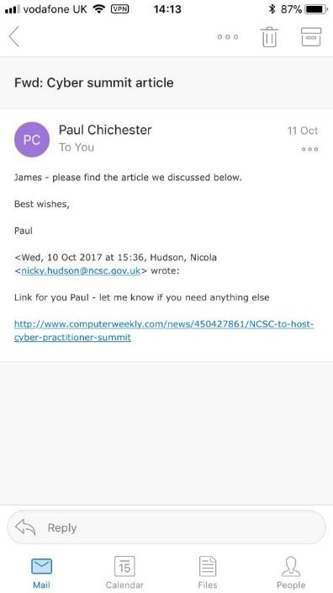
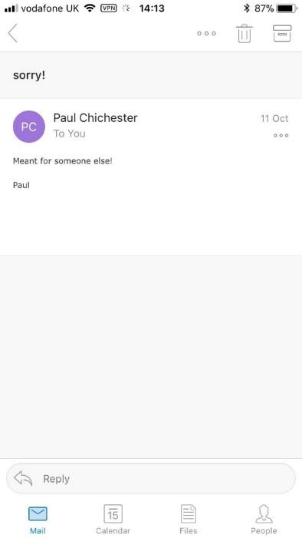

Slide 29
We need to change how we make things secure in a digital world

Slide 30
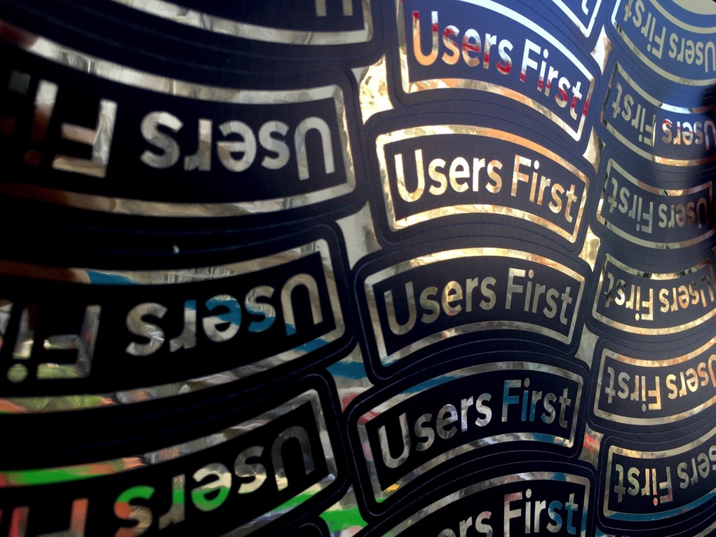

Slide 31
HM Government can’t do this alone

Slide 34
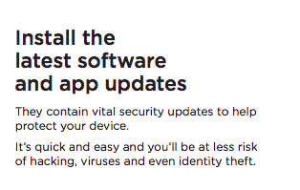

Slide 36
Regulator/ Legislator
Steward
Government
Funder
Leader
Provider
Customer

Slide 37
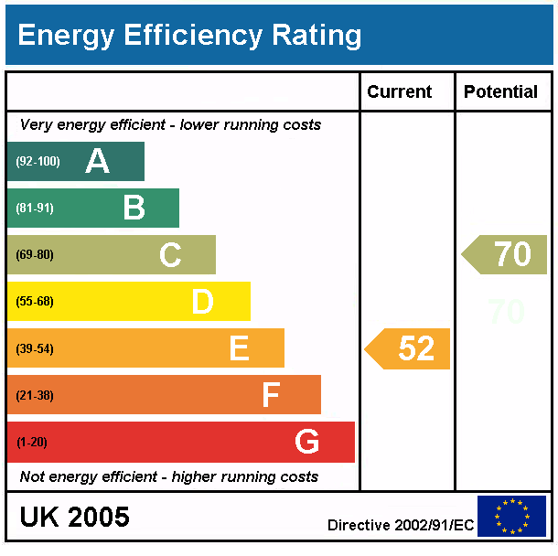

Slide 38
No one is saying this will be easy

Slide 39
The cyber security and resilience of the UK supports growth

Slide 41
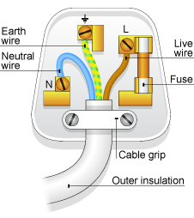

Slide 43
A digital economy secure by design

Slide 44
A digital economy secure by design

Slide 45
Some practical tips

Slide 46
GDPR opens the conversation on cyber security
Good practice

Slide 47
Bring people on the journey

Slide 48
Take policy into
everyday practice until it’s comfortable and familiar

Slide 49
A digital economy secure by design

Slide 50
Thanks!
Rowena Schoo
rowena.schoo@culture.gov.uk

